Slide 1
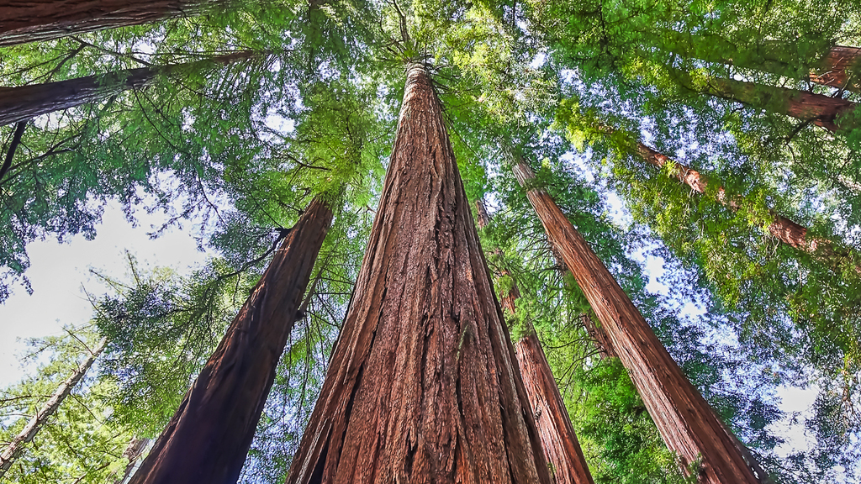
Team
Amit ghosh
Konuralp senoglu
Mohamed AbdelKadir
Nora Chaynane
Sanaullah al real
Silvana Ishak
our

Slide 2


Problem
Rent with reasonable price
List your car for rental

Slide 3

Car Rental
September 2022

Slide 4
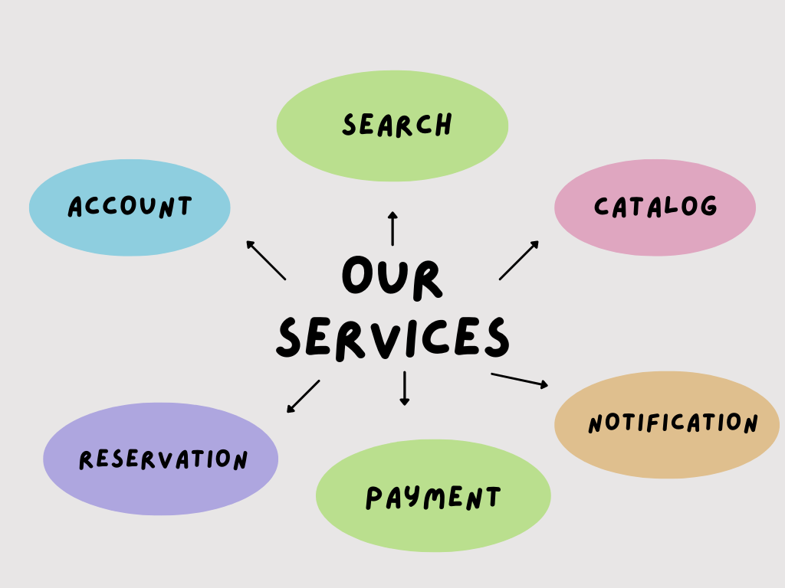

Slide 5
KAFKA
Account
Catalog
Search
Reservation
Payment
Notification
MySQL
mongo DB
API GATEWAY

Slide 6
WE USED
Kafka
K8s
Elastic-Search

Slide 7
AND
JWT
MySQL
MongoDB

Slide 8
BESIDES
Angular
CI/CD
Google Cloud

Slide 9
KAFKA
WHY

Slide 10
K8s
WHY

Slide 11
ELASTICSEARCH
WHY

Slide 12
JWT
WHY

Slide 13
MYSQL
WHY

Slide 14
Mongo db
WHY

Slide 15
DEMO TIME
Put on your seatbelts!

Slide 16
THANK YOU
SA - September 2022

